Slide 1
Kubernetes
Introduction

Slide 2
Benefits
Standardize application deployment and management

Slide 3
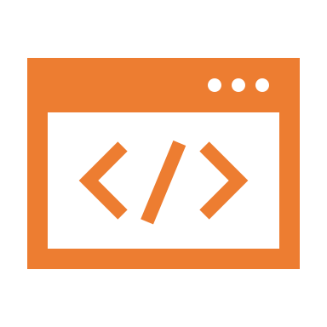
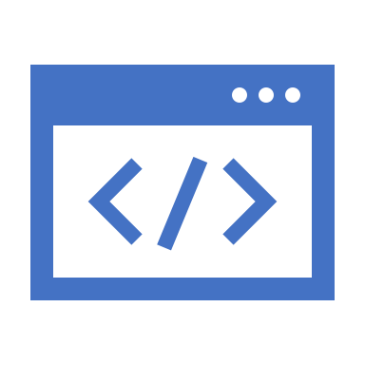
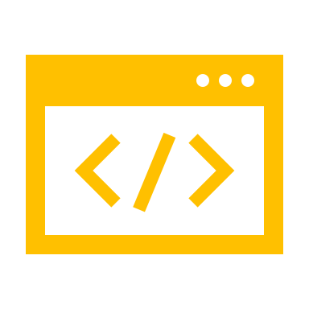
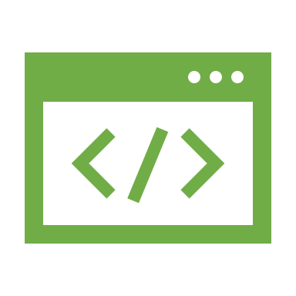

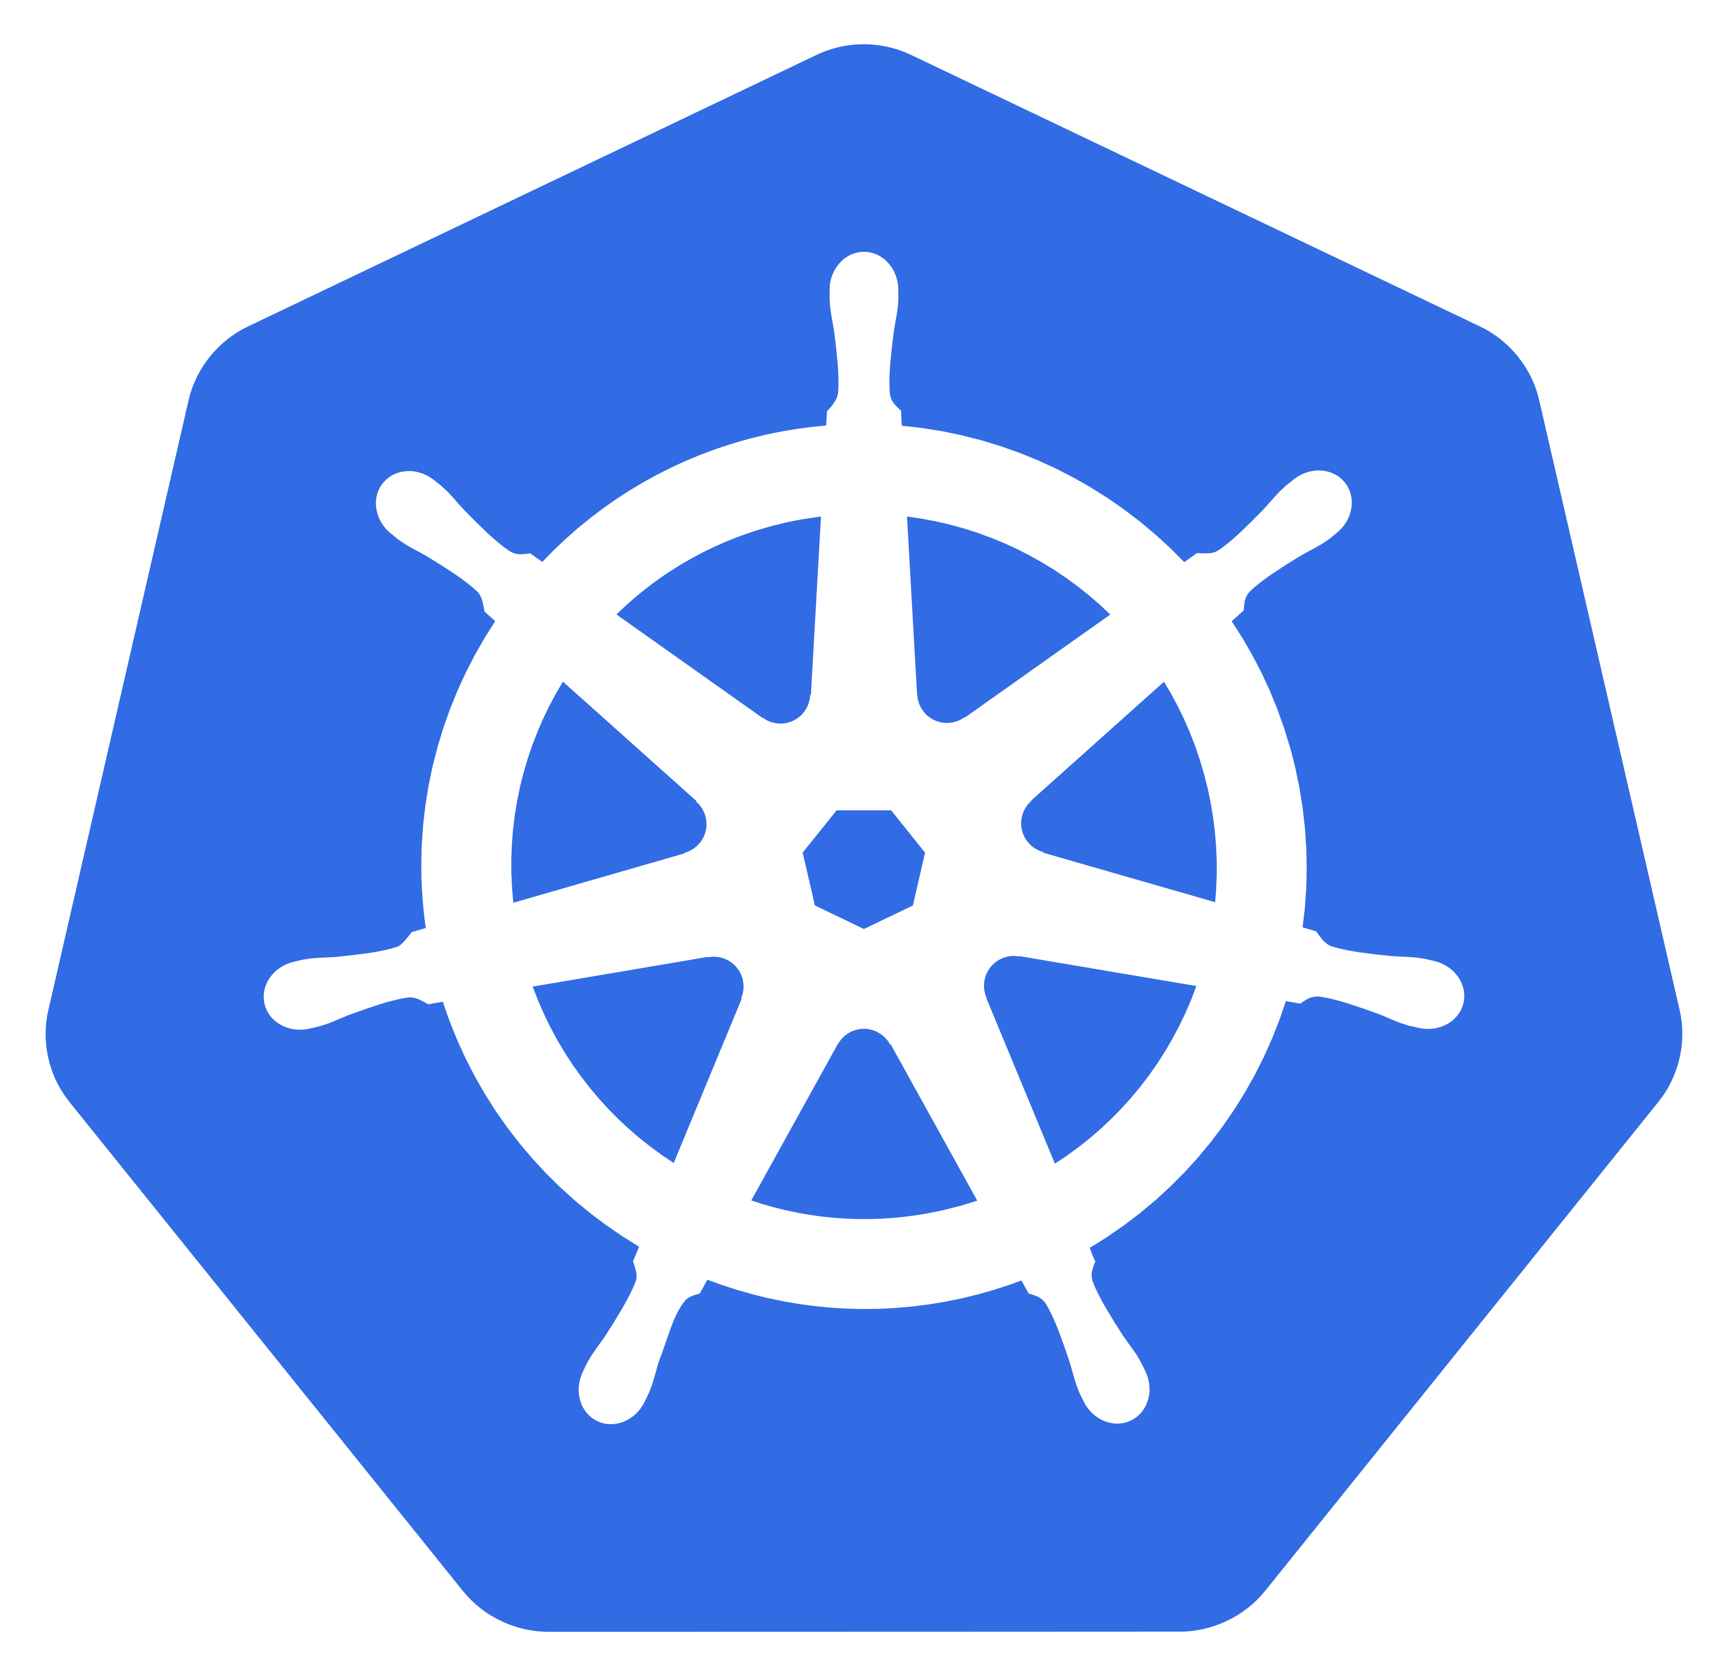
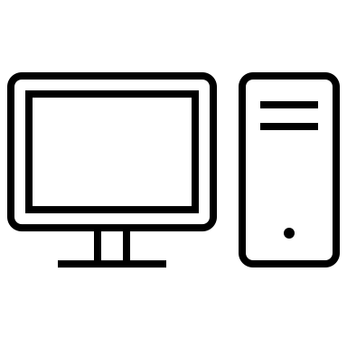
Dev and ops deploy apps via k8s
apps
Abstract away the infrastructure
computer
computer
computer
computer
computer
No need to talk to computers

Slide 4
Dev provides a description of the app design
k8s turns it into a set of running components
Standardize application deployment
Deploy apps declaratively
k8s ensures the components keep running (restarts, recreates, scales…)

Slide 5
In case you change the design…
…k8s transforms running components
Standardize application deployment
Changes in the description impose changes in the running app
Starts new
Stops removed

Slide 6
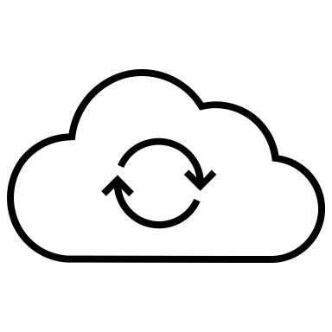
Dev and ops deploy apps via k8s
Standardize application deployment
k8s API
k8s API
k8s API
k8s API
No need to use each provider’s proprietary API to deploy and manage apps
Amazon
Google
MSFT
…
No need to talk to provider’a API

Slide 7


Dev and ops tell k8s what they want to achieve
k8s performs necessary actions, taking into account the current state of the environment
No need to daily manage Your apps
apps
Dev
infrastructure
K8s will take over the management
Ops

Slide 8
Dev and ops tell k8s what they want to achieve
k8s performs necessary actions, taking into account the current state of the environment
Keep application running smoothly
apps
Dev
infrastructure
If app crashes – k8s will restart it automatically
Ops

Slide 9
Dev and ops tell k8s what they want to achieve
k8s performs necessary actions, taking into account the current state of the environment
Keep application running smoothly
apps
Dev
infrastructure
If app crashes – k8s will restart it automatically
Ops

Slide 10
Dev and ops tell k8s what they want to achieve
k8s performs necessary actions, taking into account the current state of the environment
Automatically adjust to changing load
apps
Dev
infrastructure
k8s monitors and adjusts the number of running instances of each app to cope with increase load
It can even increase the size of Your cluster by provisioning additional nodes from Your cloud provider
Ops

Slide 11
Understanding kubernetes
k8s architecture

Slide 12
A given app may be relocated if needed
k8s exposes the cluster via API
k8s API
… as a uniform deployment ecosystem
Apps are deployed by k8s API
Apps run across all the machines in the cluster

Slide 13
OS is an interface between apps and hardware
k8s is an interface between apps and the cluster of servers
k8s = OS to a cluster
Applications
Applications
Operating System
k8s
RAM
CPU
...
Server
Server
Server

Slide 14
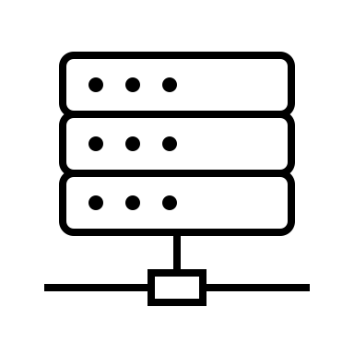
Master node(s)
Worker nodes
Control and Workload Planes
Control Plane
Workload Plane
Computers in a cluster are divided into the Control and Workload Plane
This is the brain
They run Your apps

Slide 15

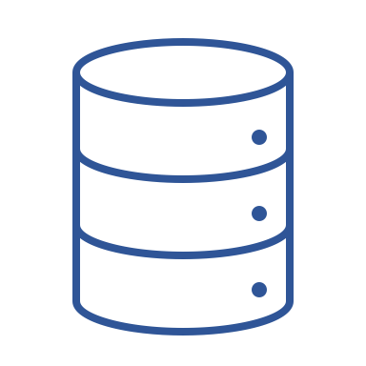
Scheduler assigns node to run each instance of a given app
Controllers perform many different tasks…
Worker nodes
Scheduler
Controllers
Control plane
k8s API Server
Devs and Ops create objects via API
etcd
API Server is stateless. It stores objects in a distributed data store
Worker nodes communicate only with the API Server

Slide 16
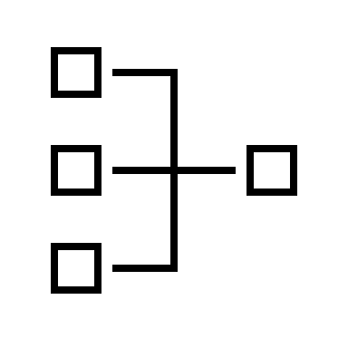
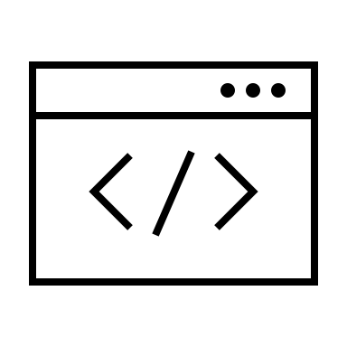
It instructs the Container Runtime (e.g. Docker) to run the apps and get their status
Kubelet Is the node’s agent
k8s API Server
Worker node
Workload plane
Kubelet
Container Runtime
Kube Proxy
Apps run in containers
The Kube Proxy creates a virtual load balancer for each app that needs it

Slide 17
A pod can have one or more containers
Each pod has it’s own IP address
Worker node 1
Worker node 2
Pod 1 IP: 10.1.0.1
Pod 2 IP: 10.1.0.2
Pod 2 IP: 10.1.1.2
Pods = groups of containers
Container
Container 1
Container 1
In k8s you deploy groups of co-located containers instead of individual containers
Container 2
Container 2

Slide 18
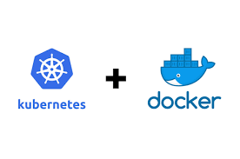
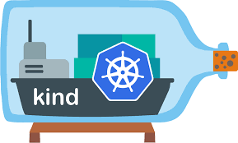
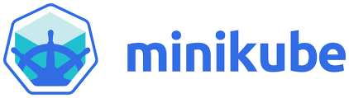
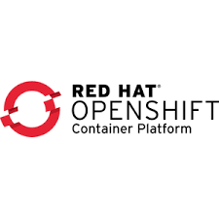
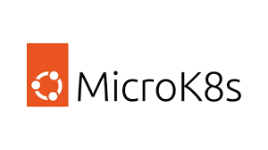
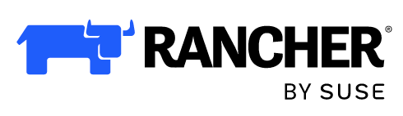
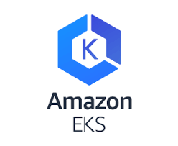
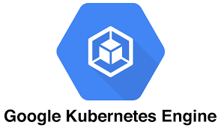
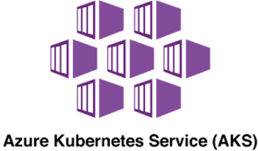
K8s flavors

Slide 19
The Control Plane components run in containers
The Kubelet runs in the VM’s OS
Single-node k8s cluster runs in a Linux VM
Linux VM
k8s Control Plane
Kubelet
Docker CLI
Docker Daemon
Deployed Containers
Apps run in containers
You can see deployed containers by invoking
docker ps

Slide 20
If you run Minikube on Linux, you can deploy k8s direclty on OS
Single-node k8s cluster runs in a Minikube’s VM
Minikube’sLinux VM
k8s Control Plane
Kubelet
MinikubeCLI
The Kubelet uses Docker to run the containers
Docker Daemon
Deployed Containers
Single node only

Slide 21
Master and worker nodes run in containers
MinikubeCLI
Control Plane Container
Worker Node 1
Worker Node 2
Kubelet
Kubelet
Docker
Control Plane Processes
CRI-O (instead of Docker)
CRI-O (instead of Docker)
Multi-node
Each node running inside a docker container
Deployed Containers
Deployed Containers
Apps containers run inside nodes containers

Slide 22
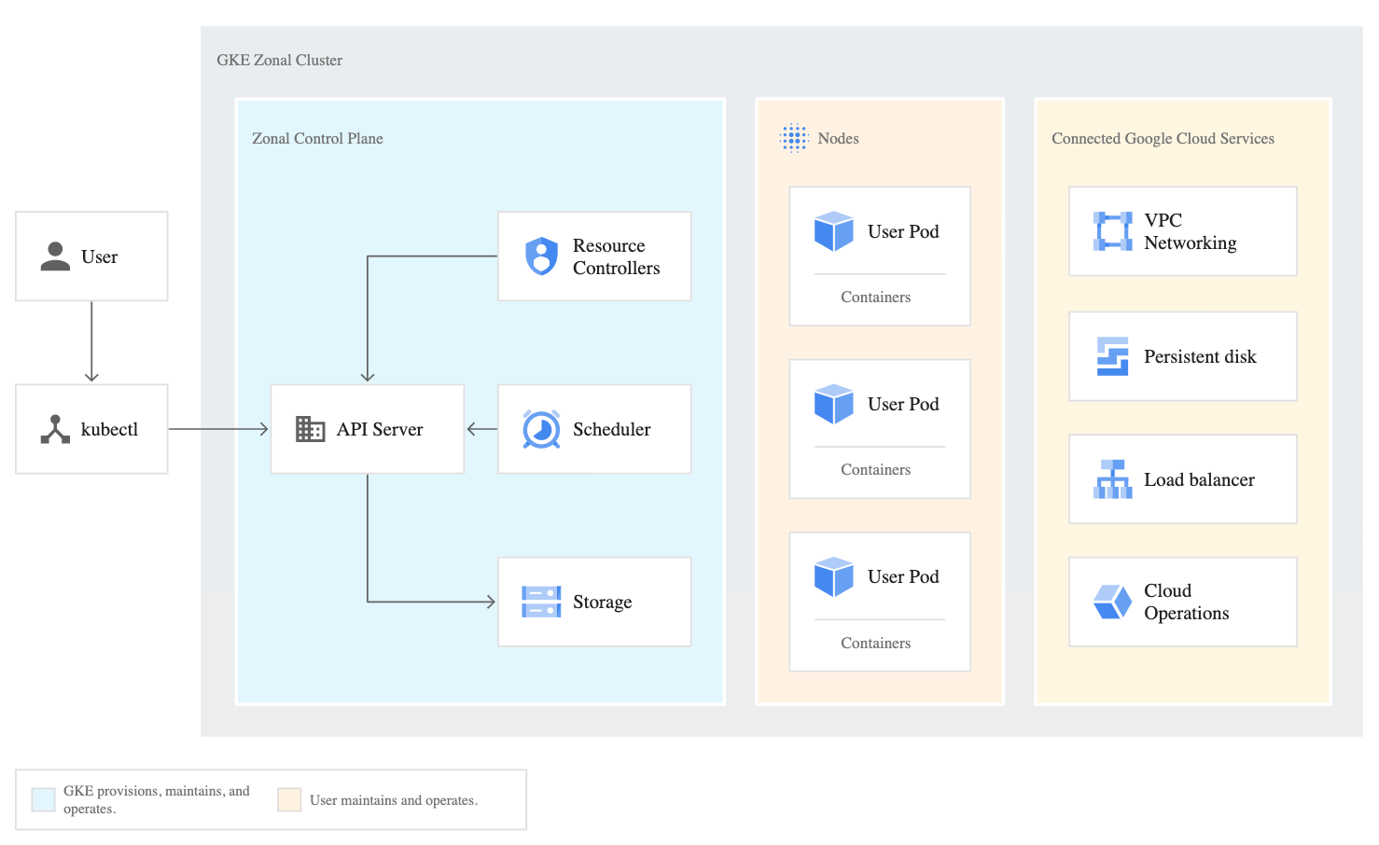

Slide 23
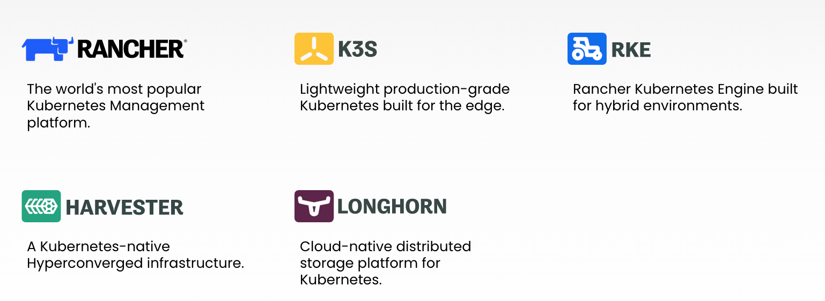

Slide 24
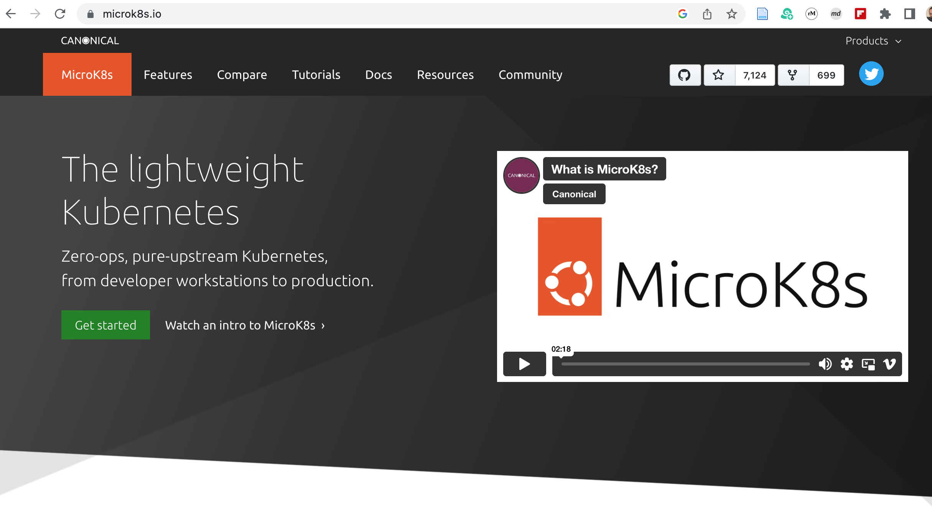

Slide 25
